Slide 1
Coursera Capstone
Open a New Gas Station in New York,US
By:Aaftaab Moosa

Slide 2
Business Problem
Statement :
To help a Business owner to set up a new Gas Refilling station in New york.
Target audience:
People who intend to open new Gas Stations or it can be used by Franchise Gas Companies to select the next location of their station.
Business Question:
Which to open a gas station so as it is most profitable?

Slide 3
Data
Foursqure API
List of all existing Gas Stations along with Road located and Latitude, Longitude details.
Traffic Volume Dataset
Hourly details of Traffic Volume on Every major Road of New York provided by https://data.cityofnewyork.us/
Geocoder API
Get co-ordinates for Roads mentioned in traffic volume Dataset

Slide 4
Methodology
Clustering High Traffic volume roads from traffic Volume dataset
Finding distance to nearest Gas station to each high volume road using Foursquare API.
Both Traffic Volume and Distance to nearest Gas station must be high for a given Location to be considered good.
Each probable location is assigned a Score, higher the score better the rank.
Plot these Points on map for Visualization
.

Slide 5
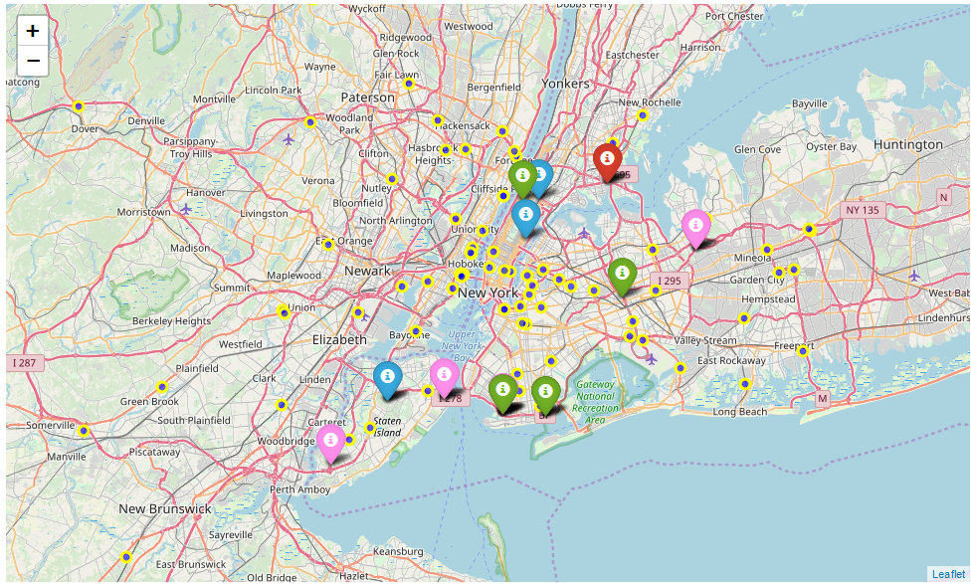
Result
The Top ranked location to open a gas Station is marked in RED
The ranks follow as RED, BLUE, PINK and GREEN markers.
There yellow Circle Marker represent already existing gas stations.

Slide 6
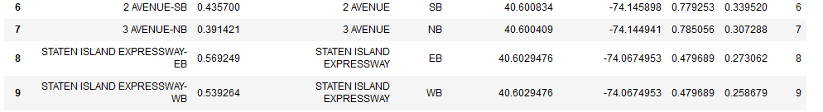
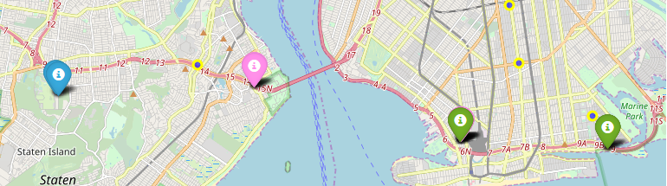
Discussion
Ranked Locations 6, 7, 8 and 9 are very close to each other
They are located on the same highway as shown in the map.
There yellow Circle Marker represent already existing gas stations.

Slide 7
Conclusion
This model can be helpful to predict the location of a new gas station in NewYork City.
More datasets can be used for more accurate predictions and model can be extended for any city.

